Slide 1
The Body Electric
Michael Mattioli
Professor of Law
Indiana University (Bloomington)
Notes:
Preliminary Comments:
Hi, I’m Michael Mattioli and I’m a Professor of Law at Indiana University in Bloomington
Today, my talk is about a project under development. The project is about assistive technology and public policy.
I hope this will become a book. It also might lead to some academic papers.
I’d appreciate any ideas!

Slide 2
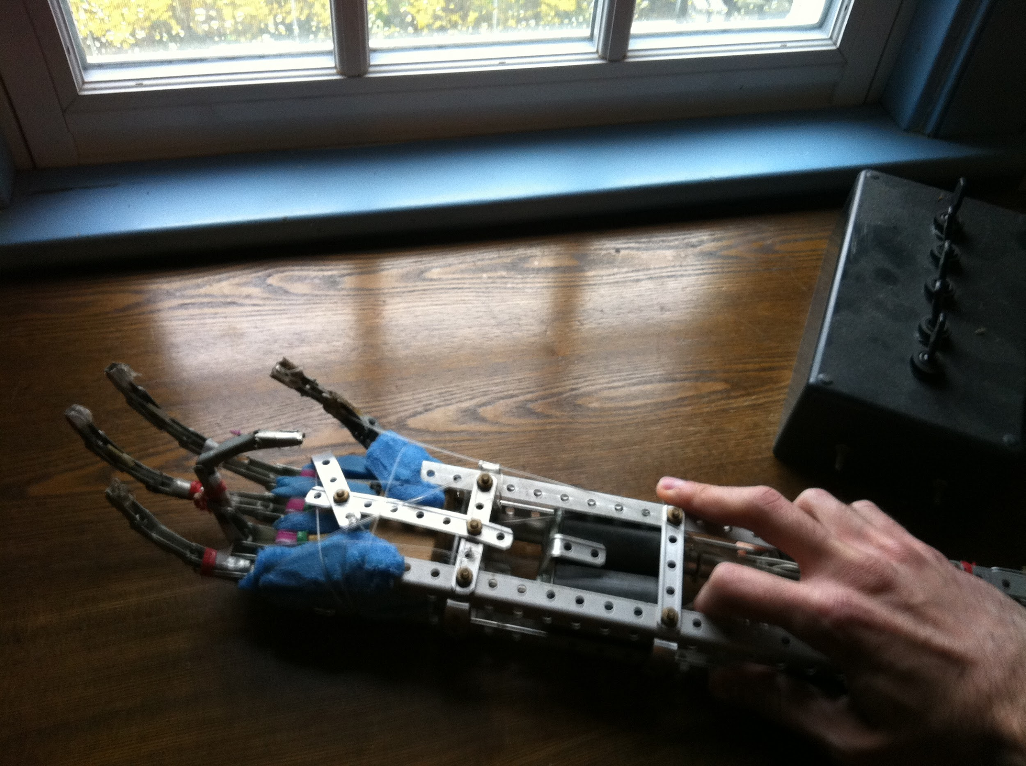
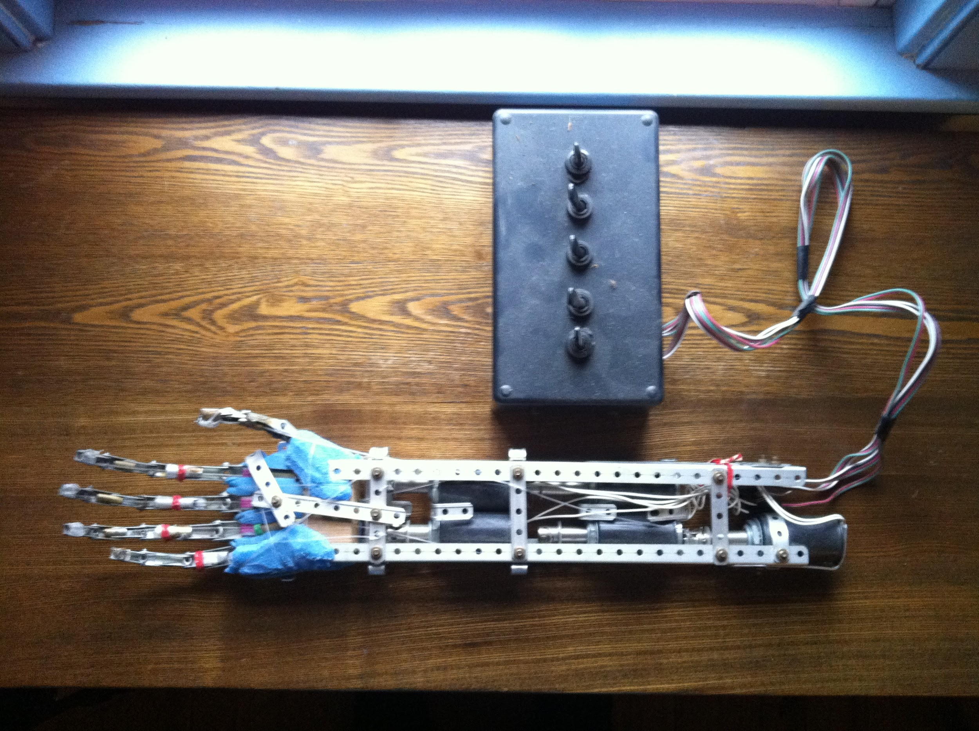
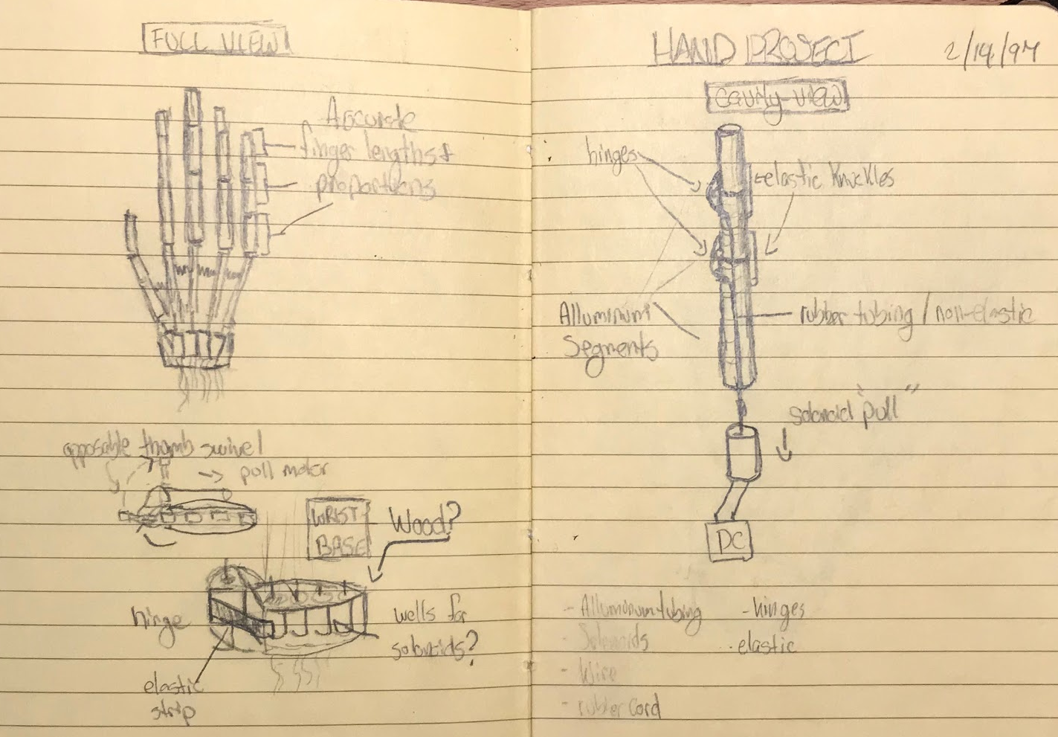
Notes:
I’d like to start with a short personal story that explains what I’m interested in.
Like many high schools, mine gave me a few weeks to complete a personal project before graduating - a senior design project.
The robotic arm you see on this slide was my project.
It’s made of fishing wire, and an erector set, and solenoids donated from a model trail maker I sent a letter to. 1997.
As it happened, my grandfather was an upper-body amputee. He had lost his arm when he was a teenager. and the few sporadic visits I had with him when I was a kid made an impression on me. He didn’t use a prosthetic. He had practical challenges, and the emotional impact of this injury on him and my extension his immediate family, was, I think, beyond anything I could have understood as a child.
So, the question of how to cope without an arm - it was something I thought about. In part, this high school project was a stepping stone that led me to study engineering and later working as an engineer.

Slide 3
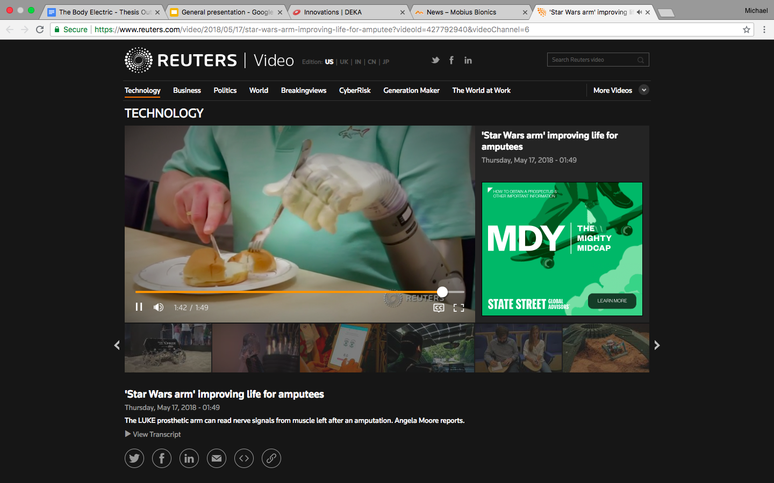
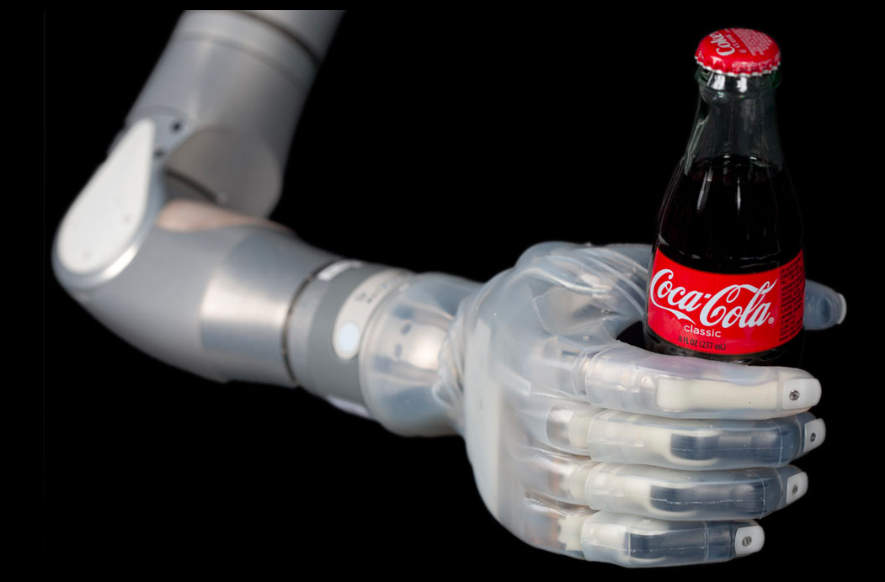
Notes:
In the past few years, this technology has taken leaps and bounds.
This is the so-called “Luke Arm” - named after Luke skywalker and funded primarily by DARPA.

Slide 4
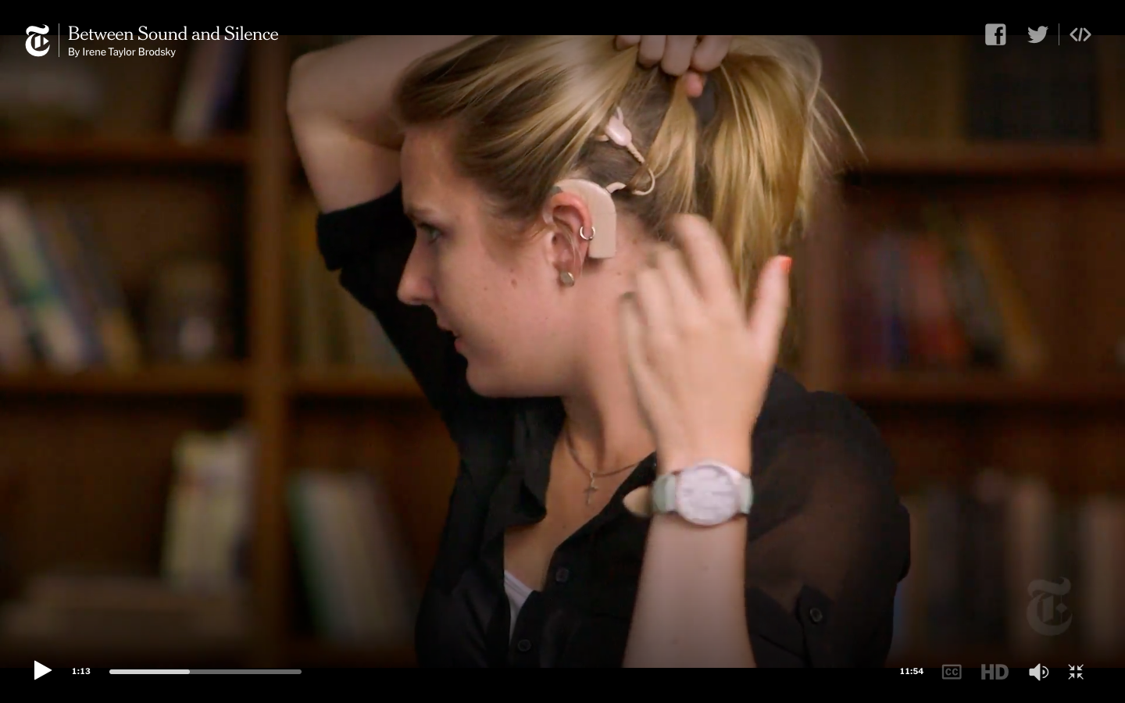
Notes:
And videos of people having their cochlear implants turned on have become a meme

Slide 5
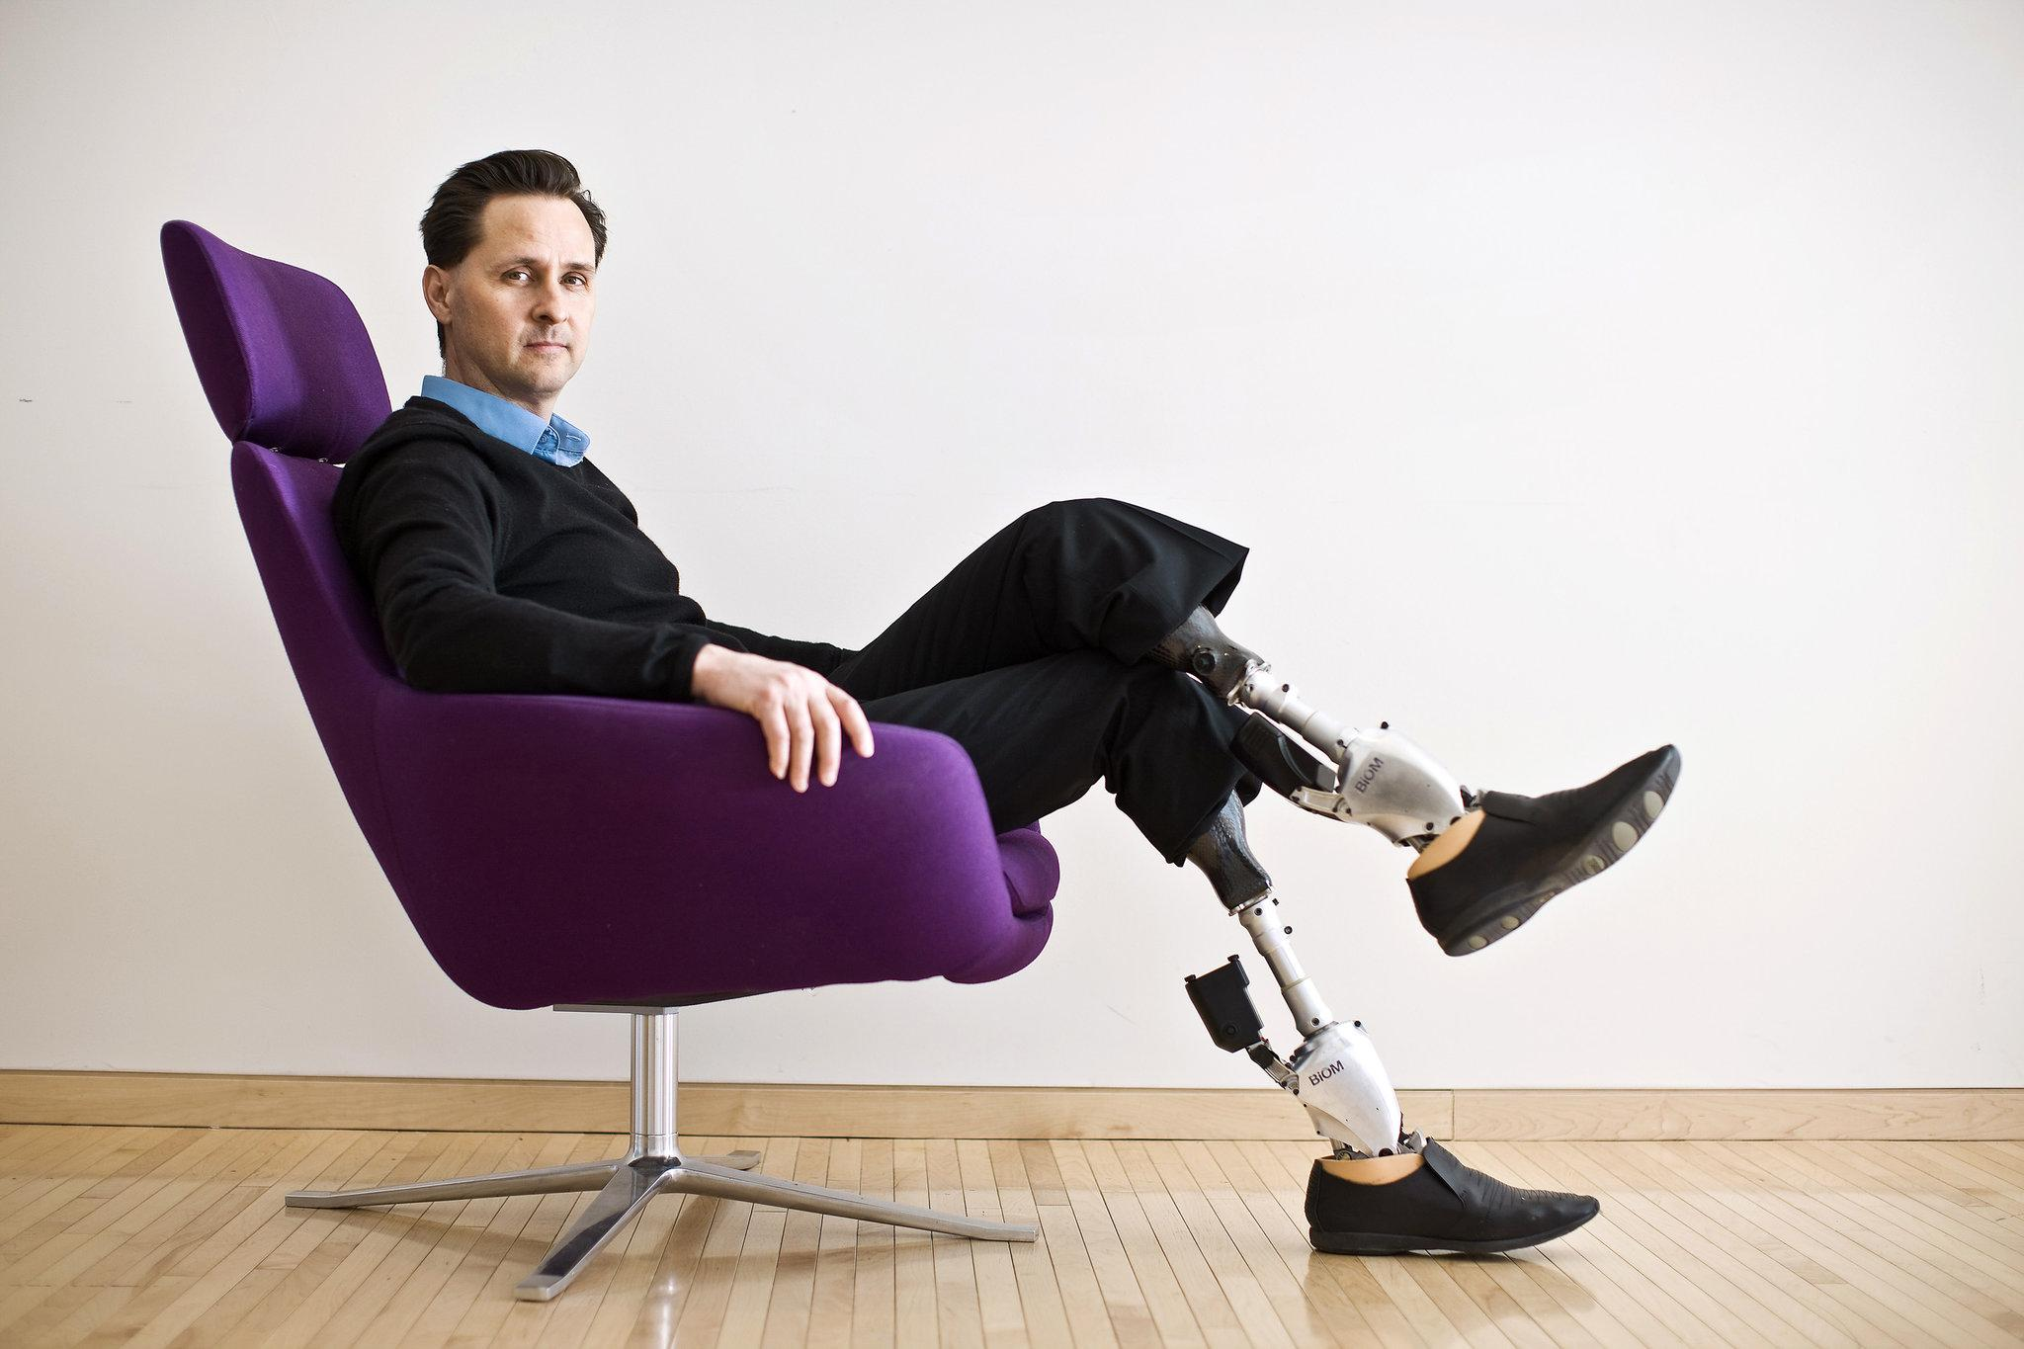
Notes:
Hugh Herr is an American rock climber, engineer, and biophysicist.Wikipedia
MIT Professor Hugh Herr, who heads the Biomechatronics group at the MIT Media Lab,
Someone without the legs he was born with can walk

Slide 6
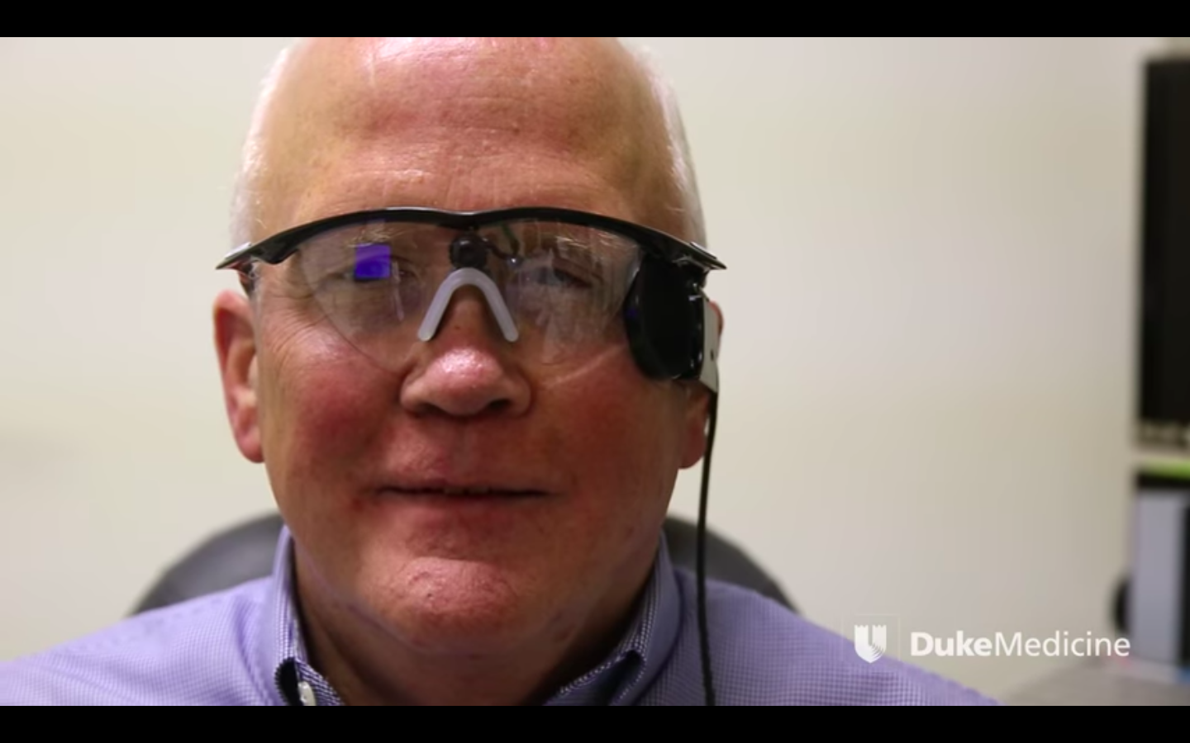
Notes:
Larry Hester, 66, has been blind for half his life from a condition called retinitis pigmentosa. In September, 2014, an electronic stimulator was surgically implanted in his left eye. On October 1st, 2014 Duke eye surgeon Dr. Paul Hahn turned it on for the first time. While the device does not restore vision in the normal sense, it provides light-and-darkness differentiation.
Seeing through SOUNDSCAPES
People with poor vision can see thanks to technology and apps

Slide 7
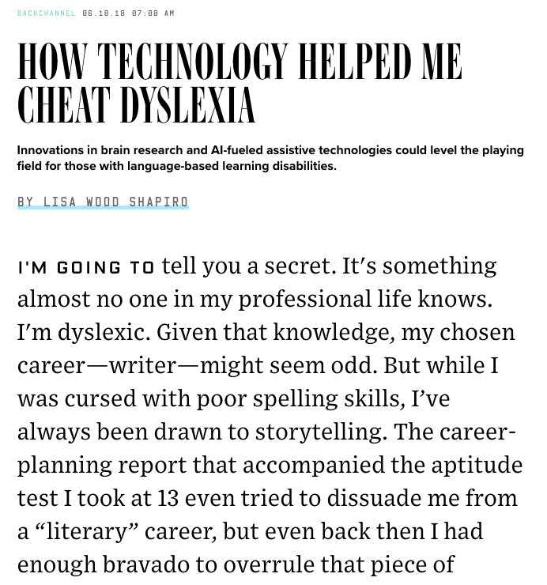

Notes:
And then there are the less conspicuous technologies that are bubbling up. A reporter recently “came out” as a dyslexic who has managed to mask her problem through the use of grammarly - a tool that uses AI to help people perfect their grammar.

Slide 8
Technologies
Mobility:
Upper-body prosthetics
Lower-body prosthetics
Autonomous vehicles
Sensory:
Cochlear implants
Vision prosthetics
Cognitive
Neural “lace” to address mental disorders
Memaory aids
Devices to assist with movement disorders (see mobility)
Notes:
I think these technologies are uniquely important.
They offer economic benefits by allowing people to find work they couldn’t otherwise do, and in some cases, by eliminating the need for long-term care.
They offer socio-economic benefits as well. Some disabilities have been causually connected to academic performance and high rates of unemployment.
They also offer autonomy, independence, and in some cases, a degree of dignity.
I can’t help but think that had my grandfather had his accident in the 2020s instead of in the 1930s, his future life might have looked different.
The law is sensitive to all of this. In fact, when most people talk about disability and assistive technologies, they think of bodies of law like this:

Slide 9
Intersections With Disability Law - e.g.,
Americans with Disabilities Act
Assistive Technology Act of 2004
Individuals With Disabilities Education Improvement Act of 2004
Hearing Aid Compatibility Act of 1988
Telecommunications Act of 1996

Slide 10
Problems (suggested by anecdotes):
Level of innovation investment may be sub-optimal
Interests of funding sources may be misaligned with interests of society
Availability (devices are expensive)
Impact on users (AI and data collection)
Notes:
Motivation
R&D: They are limited, and there’s some reason to think innovation isn’t as robust as it could be (important innovation sources include the military and users, but private industry seems only to be dipping the toe into the water).
Availability: These technologies are expensive! The assistive products industry primarily serves high-income markets
Impact on Users: Artificial intelligence is increasingly important to these classes of devices, and I think this represents the greatest potential and some of the greatest concerns that span the assistive tech landscape. Be specific: privacy, safety (cybersecurity)

Slide 11
Research Questions
& My Approach
Notes:
I want to understand
I want to understand how public policy influences how these technologies are developed,
I want to understand what role the cultural backdrop plays
How available they are to the people they were designed to serve
And any problems or concerns that might come up after commercialization (Particularly important in light of the introduction of AI to things)
And again, what I’m interested in is bionics for disabled people - not necessarily life-saving medical devices.
Method
Ethnographic case studies
Interviews with users and inventors, possibiliy executives are tech companies

Slide 12
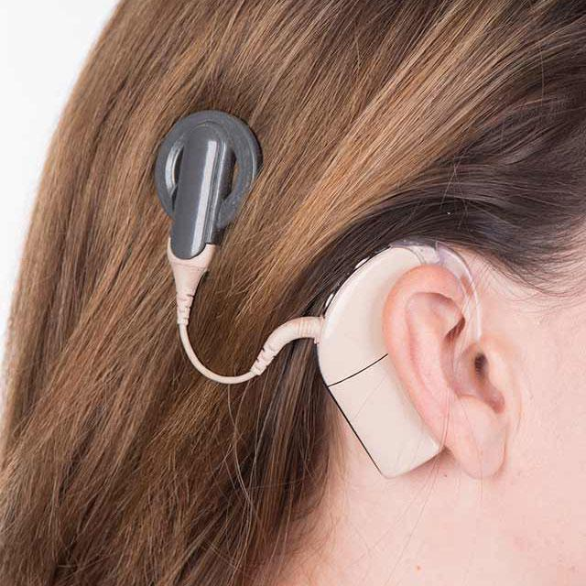
Cochlear Implants
Medical culture,
Deaf culture,
Corporate culture,
AI, data, and privacy
Notes:
Each chapter tells the story of a user, explaining their disability and how they came to find certain technologies.
The chapter then describes the history of treating the limitation or disability,
the development of the technology,
issues related to commercialization, affordability,
safe and beneficial use.
Some chapters pay special attention to post-sale concerns, such as privacy or AI ethics.

Slide 13
Electrically stimulating the ear
Notes:
1700s: Luigi Galvani discovered that animal tissue responded to electricity. Alessandro Volta, who taught physics at the University of Pavia, made important jumps too.
Alexander Graham Bell / teaching the deaf / his mother and wife were deaf
Deafness was a central interest in his life and his desire to see deaf people assimilate into broader society is … complicated and controversial. But it led to the development of the telephone.
“The invention of the telephone had led to the first electronic hearing aids by making it possible to manipulate attributes of sound like loudness and frequency as well as to measure distortion.”
Fascinating in that the spread of telephones at once changed the world in a way that made it hard for deaf people to particpate, and yet laid the groundwork for technologies that could help them.

Slide 14
How to encode electrical information so the brain can understand it?
Notes:
The central problem: how to encode the electrical information so the brain could understand it.
Bill House was the first American to work on the idea of electrically stimulating the ear to restore hearing.
He came up with a solution: an electrode thread made with varying flexibility threaded into the snail shaped part of our ears called the cochlea, manipulating frequency and amplitude in ways that did the trick.
Early 1960s, hired an engineer. The engineer saw commercial potential but House’s mission was altruistic.

Slide 15
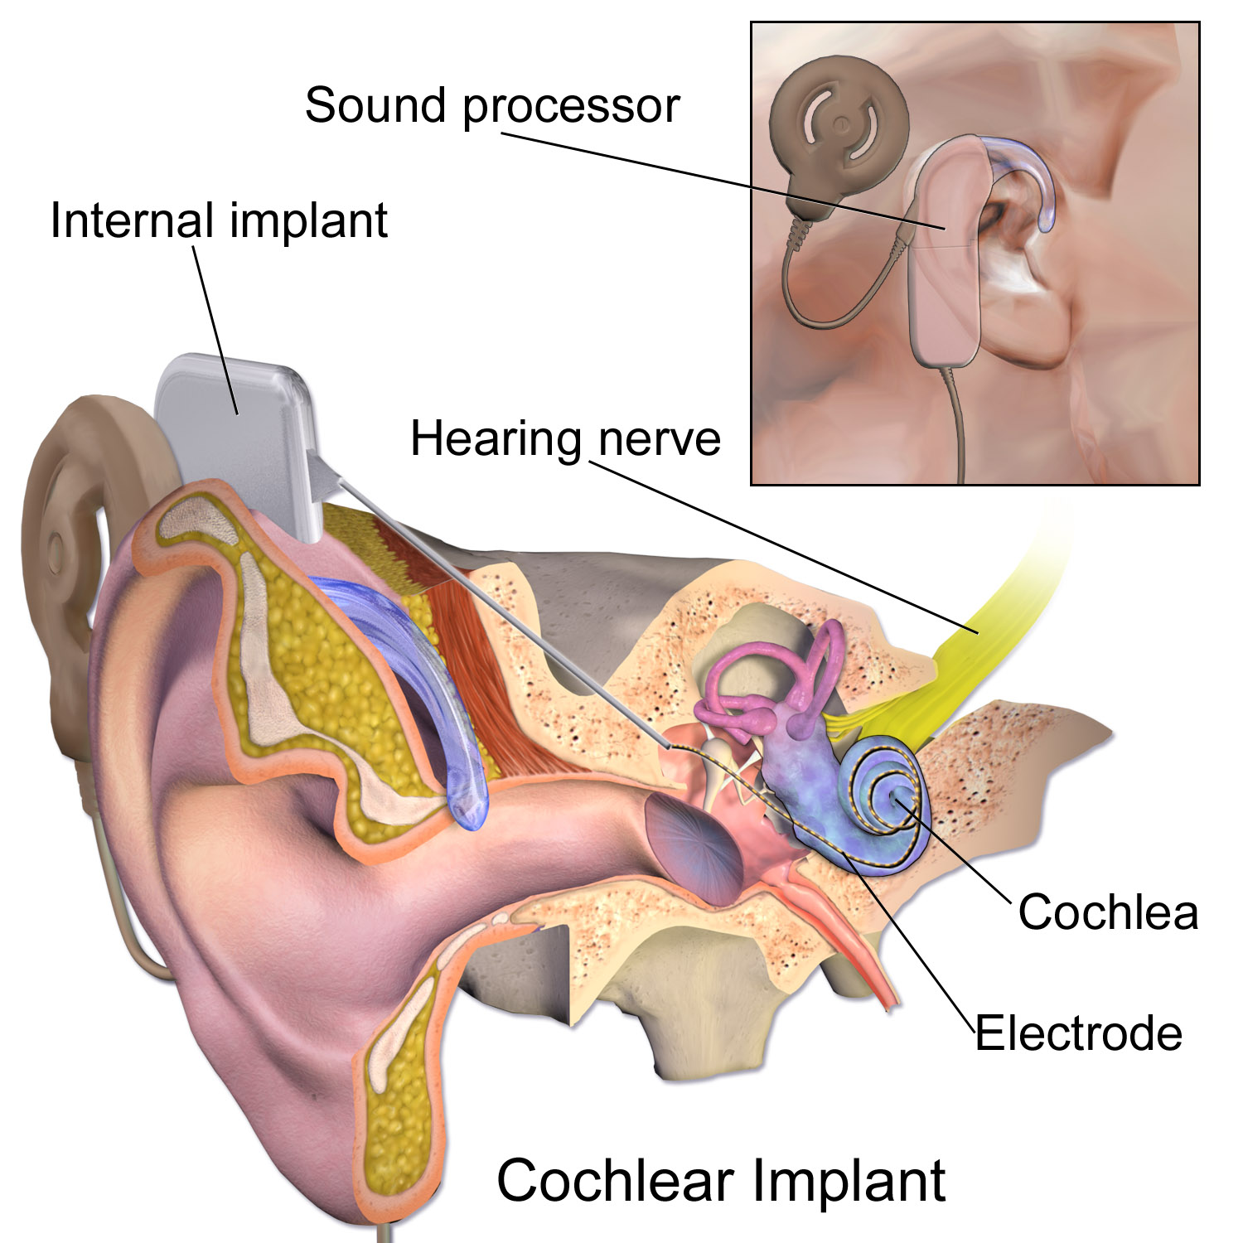
Blausen.com staff (2014)

Slide 16
“For the first time a device can, to a degree, replace an organ of the human senses.”
Mark Novitch, FDA Deputy Commissioner
Notes:
The FDA approved the device he invented in 1984.

Slide 17
“I felt [patenting] would restrict others who might want to pursue this promising lead.”
William House
Notes:
Consistent with Kathy Strandburg’s work on cultural norms with respect to patenting in the world of medicine

Slide 18
Sound and Fury
Notes:
Despite the fact that it worked, not everyone agreed that it was good.
Sound and Fury - documentary from the year 2000. The story of a family torn apart.
A vivid look at the discomfort felt by deaf people about the cochlear implant.
Deaf parents worried that that a cochlear implant will change their child’s personality and make her different from her family.
The most compelling arguments are made by the 4-year-old girl who wishes to get the implant: it’s important to hear a smoke detector, a baby crying, a house falling down, etc.
(Heather graduated from Harvard Law last year.)

Slide 19
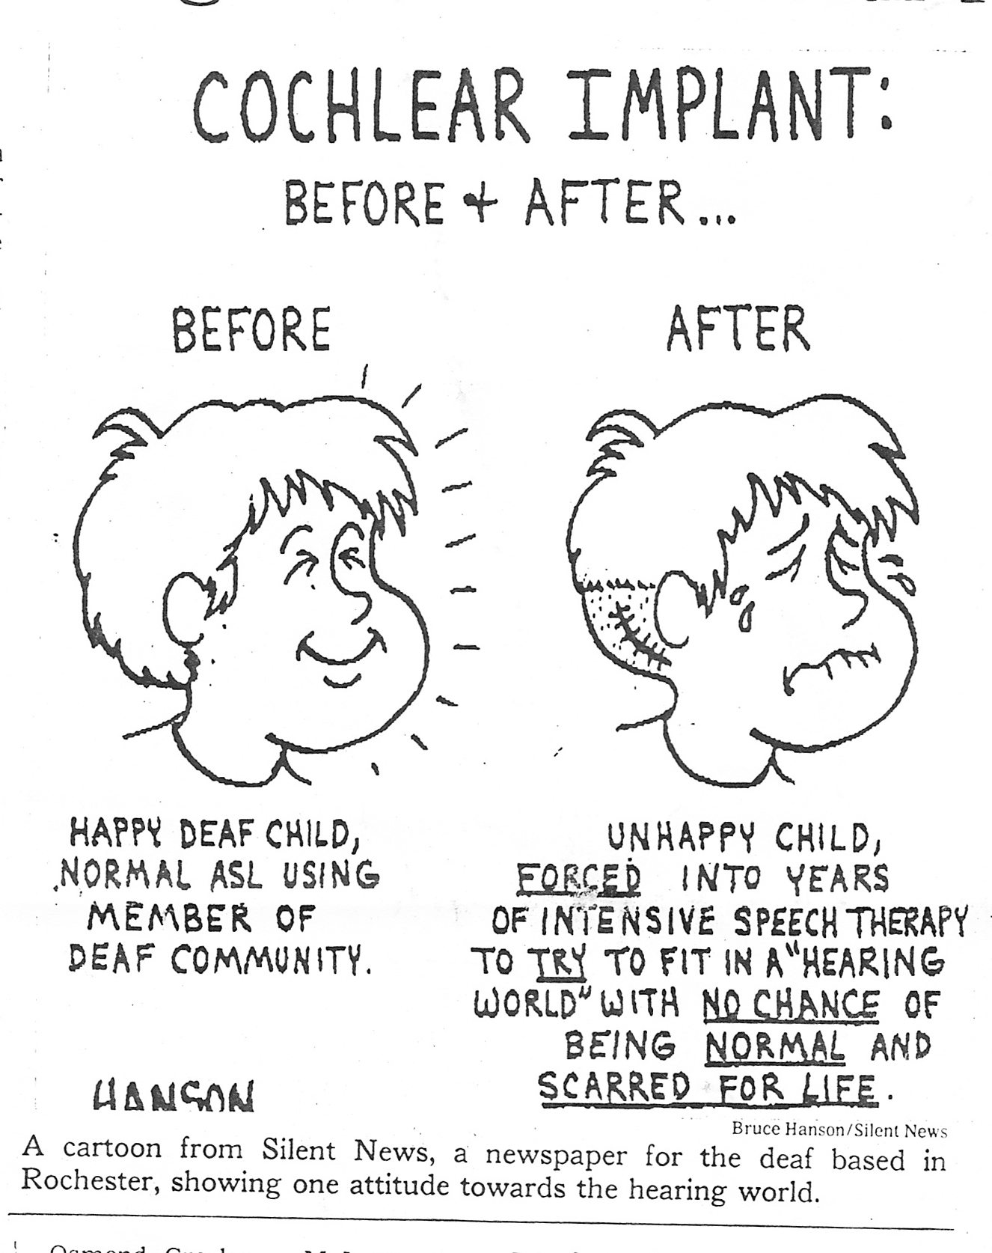
(A cartoon from Silent News, a newspaper for the deaf based in Rochester.)

Slide 20
“I know what’s best for my daughter”
“No, you don’t.”
“Look at me, mom. Are you telling me I don’t lead a succssful life?”
“Sound and Fury” (2000)

Slide 21
About $100,000
(per ear)
Notes:
As of 2013, the three cochlear implant devices approved for use in the U.S. were manufactured by Cochlear Limited (Australia), Advanced Bionics (a division of Sonova) and MED-EL (Austria).
In 2004, more than 90 percent of all commercial health plans cover cochlear implants.

Slide 22
Recent Patent Litigation
Notes:
Law360, New York (January 24, 2014, 9:32 PM EST) -- A California federal jury served Cochlear Ltd. with a $131.2 million verdict on Thursday, finding that the Australian-based company had infringed two patents related to technology for cochlear implants owned by the Alfred E. Mann Foundation for Scientific Research.
The very thing that House wanted to avoid has played out here.
Patent incentives aren’t totally absent from this story. It’s not a case of innovation without law.
And we have an example of a basic technology being introduced and laying the groundwork for a patent environment

Slide 23
Artificial Intelligence
& User Data
Primary uses:
Calibration
Predicting outcomes
Notes:
How calibration works: In response to the tender requirement, what Cochlear did was build a product called Cochlear Link that essentially transfers data to Cochlear, with that data available to global clinical support staff and repair technicians. Cochlear now receives the data in real-time, constantly syncing recipient data via the Amazon Web Services (AWS) cloud.
AI-based calibration
Separately: The researchers claim that they successfully developed a machine learning algorithm which predicts language ability in deaf children who have received a cochlear implant: https://www.techemergence.com/ai-for-hearing-loss-tech-advances-in-hearing-aids-predicting-hearing-loss/ “Using an advanced machine learning algorithm, we can predict individual children’s future language development based on their brain images before surgery. Such prediction ability is a key step in achieving personalized therapy, which could transform many lives.”
The core question: will training data be shared? Between whom? Or will it be kept proprietary? (For instance: “The algorithm is trained on a high volume of images captured using magnetic resonance imaging (MRI). Images were obtained from pediatric cochlear implant (CI) candidates implanted below 3.5 years of age. The machine learning algorithm is trained to identify, atypical patterns which are characteristic of hearing loss early in life.”)
How to balance the need for information-sharing and the need to preserve and protect the privacy of disabled people? Could information-sharing be tied to insurance?
Integration with Smart Phones and Apps
Artificial intelligence
New questions for Deaf culture: Founded in 2016 and based in Budapest, Hungary, SignAll claims that its platform automatically translates sign language into text using computer vision and natural language processing. Does this mean fewer people will have a need to learn signing? Or will it provide new opportunities for communication?

Slide 24
A Broader Look
Disability Communities
Medical professional standards and norms
Military (DEKA arm, neural implants)
User innovation (Prosthetics)
Private cooperation and volunteerism (BeMyEyes)
Patent incentives
FDA
Insurance
Disability Policy

Slide 25
Accessibility tech is important, and unlikely to thrive under traditional incentives alone.
Notes:
What I hope to learn:
Is our legal system doing enough to help ensure that assistive technologies get developed and commercialized?
Where does it succeed?
Where might it be falling short?
What challenges are appearing today or appear to lay ahead?
On a theoretical level, I hope it will help me understand a question that’s always interested me: to what extent should the law help us? Autonomy - liberty.

Slide 26
To come up with smart policies, we need to understand the cultural forces at play.
Notes:
What I hope to learn:
Is our legal system doing enough to help ensure that assistive technologies get developed and commercialized?
Where does it succeed?
Where might it be falling short?
What challenges are appearing today or appear to lay ahead?
On a theoretical level, I hope it will help me understand a question that’s always interested me: to what extent should the law help us? Autonomy - liberty.

Slide 27
Thanks.
michaelmattioli.org

